Slide 1


Slide 2
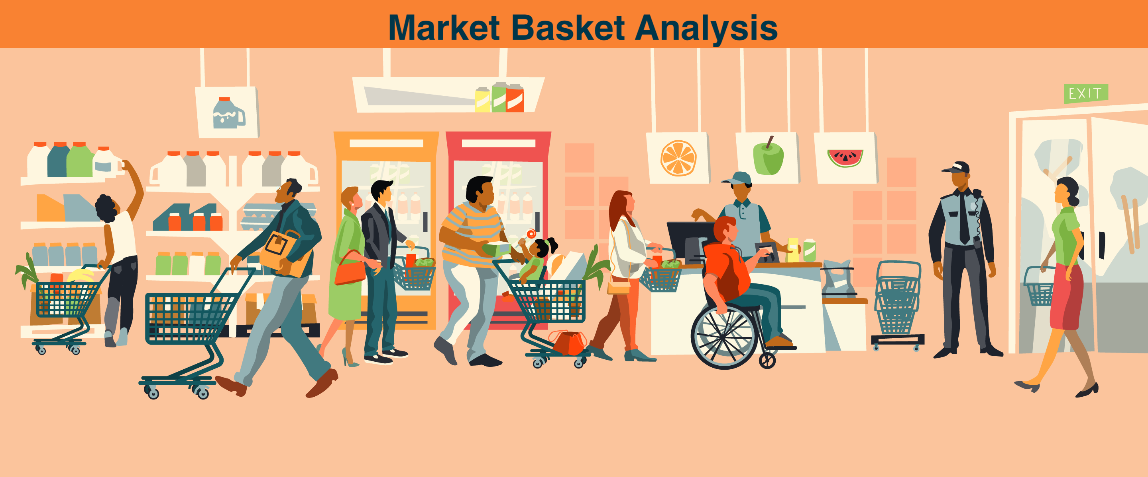
MARKET BASKET ANALYSIS
Name : Akanksha Lavande
Batch : ML9

Slide 3

C O N T E N T S
Introduction
Objective
Applications
Libraries
Algorithm
How does Market Basket Analysis work
Advantages & Disadvantages
Conclusion
Reference

Slide 4
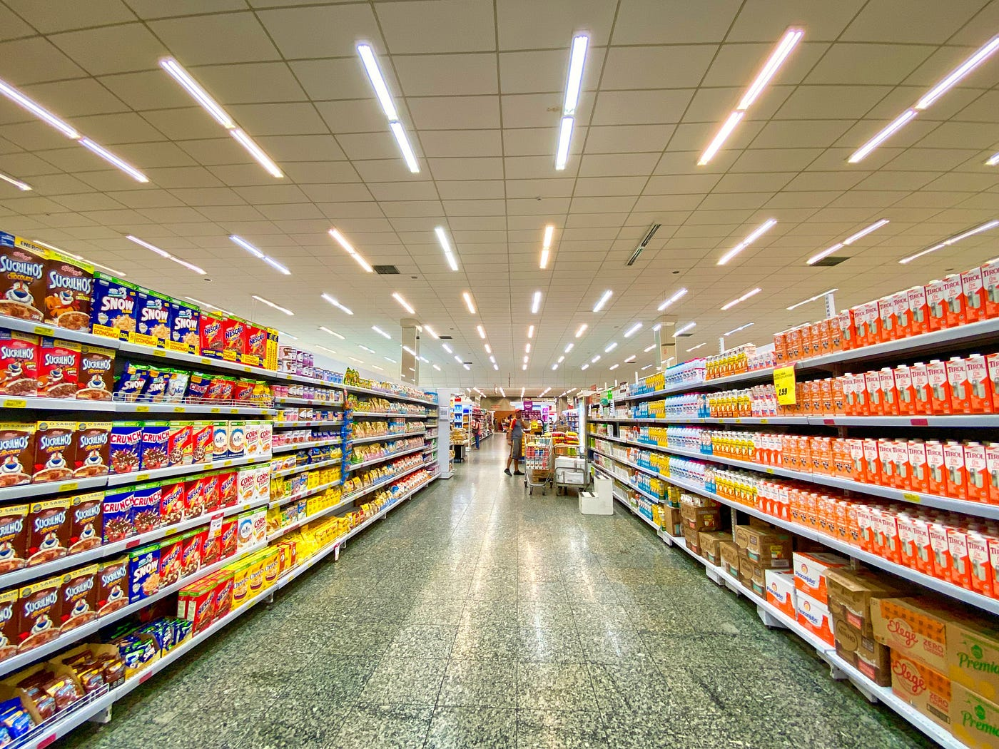

I
T
O
U
T
O
N
R
D
C
I
N
Market basket analysis is a data mining technique used by retailers to increase sales by better understanding customer purchasing patterns.
Finding items that buyers desire to buy is the major goal of market basket analysis.
Market basket analysis may help sales and marketing teams to develop more effective product placement, pricing, cross-sell, and up-sell tactics.

Slide 5
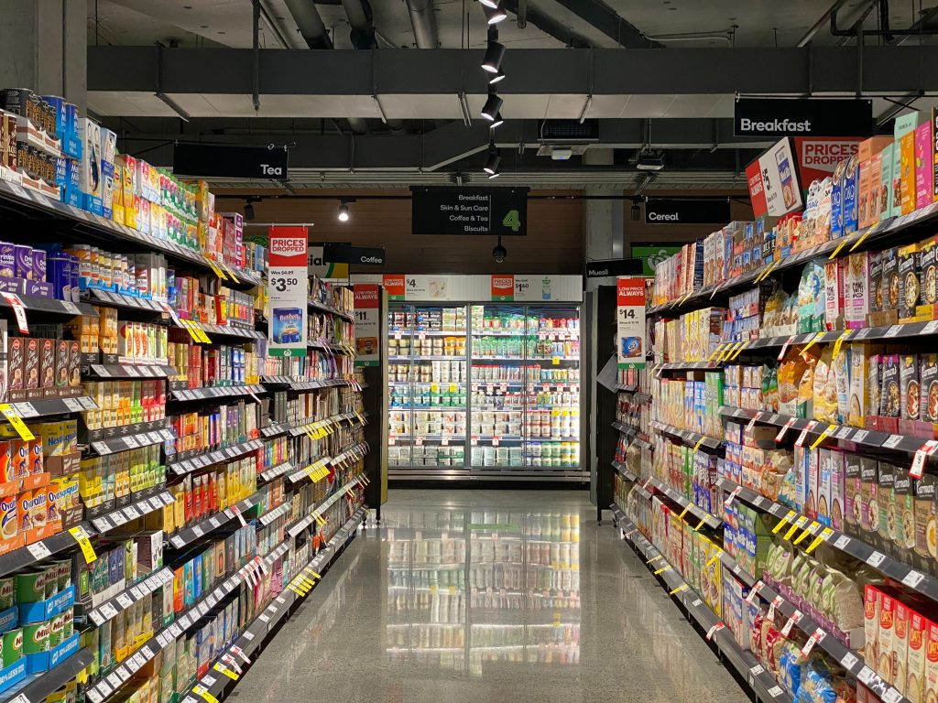

O
J
C
I
E
B
E
T
V
To find frequently purchased items sets from large transactional database.
Finding items that buyers desire to buy is the major goal of market basket analysis.

Slide 6

About the Dataset
File name: Assignment-1_Data
List name: retaildata
File format: . xlsx
Number of Row: 522065
Number of Attributes: 7
BillNo: 6-digit number assigned to each transaction. Nominal.
Itemname: Product name. Nominal.
Quantity: The quantities of each product per transaction. Numeric.
Date: The day and time when each transaction was generated. Numeric.
Price: Product price. Numeric.
CustomerID: 5-digit number assigned to each customer. Nominal.
Country: Name of the country where each customer resides. Nominal.

Slide 7
About the Dataset
Market basket analysis with Apriori algorithm
The retailer wants to target customers with suggestions on itemset that a customer is most likely to purchase .I was given dataset contains data of a retailer; the transaction data provides data around all the transactions that have happened over a period of time. Retailer will use result to grove in his industry and provide for customer suggestions on itemset, we be able increase customer engagement and improve customer experience and identify customer behavior. I will solve this problem with use Association Rules type of unsupervised learning technique that checks for the dependency of one data item on another data item.

Slide 8

Applications of Market Basket Analysis
Market basket analysis can increase sales and customer satisfaction. Using data to determine that products are often purchased together, retailers can optimize product placement, offer special deals and create new product bundles to encourage further sales of these combinations.

Slide 9


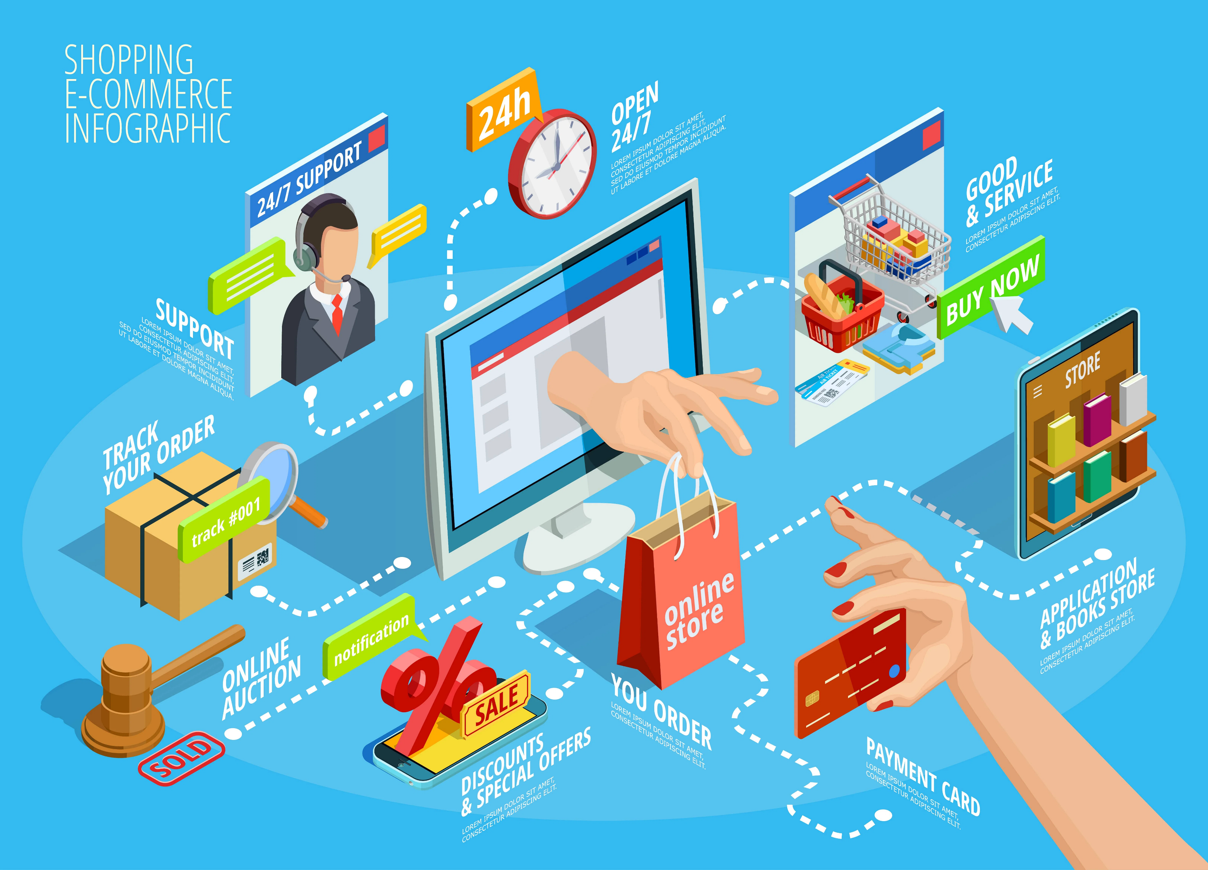




Retail and E-commerce
Online Recommendations
Telecommunications
Hospitality Industry
Health care

Slide 10


L
B
A
I
S
I
R
R
E
PANDAS
SEABORN
NUMPY
MATPLOTLIB

Slide 11
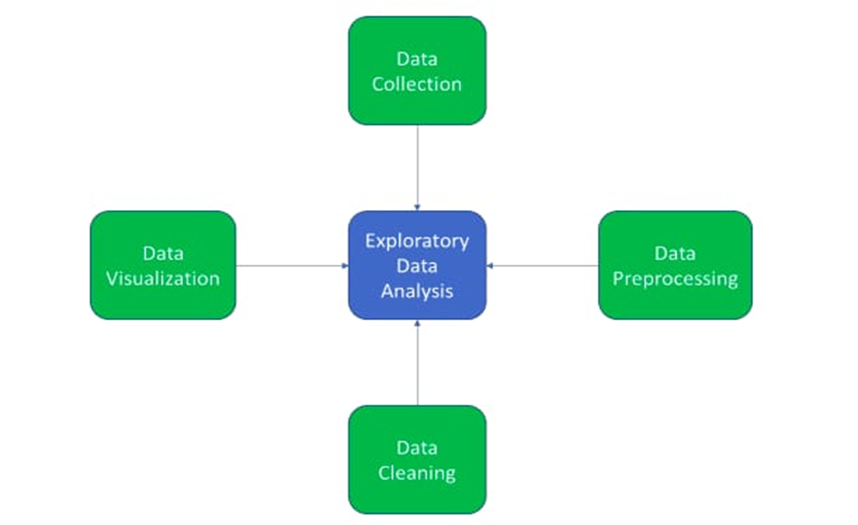
E
D
A
Exploratory data analysis (EDA) is used by data scientists to analyze and investigate data sets and summarize their main characteristics, often employing data visualization methods.

Slide 12
ADVANTAGES OF EDA
The main purpose of EDA is to help look at data before making any assumptions. It can help identify obvious errors, as well as better understand patterns within the data, detect outliers or anomalous events, find interesting relations among the variables.
DIS-ADVANTAGES OF EDA
Exploratory research comes with disadvantages that include offering inconclusive results, lack of standardized analysis, small sample population and outdated information that can adversely affect the authenticity of the information

Slide 13


ALGORITHM
Apriori Algorithm
Apriori is an algorithm for frequent item set mining and association rule learning over relational databases.
Apriori Algorithm is a Association Rule algorithm used in market basket analysis.
It is also considered accurate.
It helps to find frequent itemsets in transactions and identifies association rules between these items.
Apriori algorithm

Slide 14
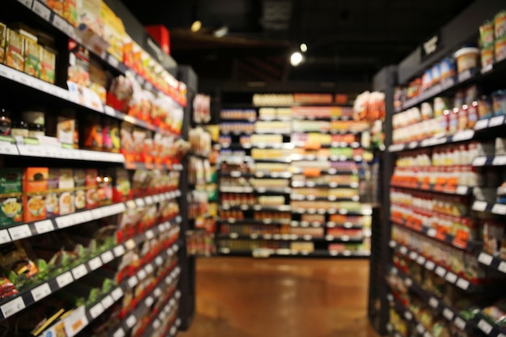
With the help of the Apriori Algorithm, we can further classify and simplify the item sets that the consumer frequently buys. There are three components in APRIORI ALGORITHM :
SUPPORT : It has been calculated with the number of transactions divided by the total number of transactions made,
Support = freq(A, B)/N
CONFIDENCE : Whether the product sales are popular on individual sales or through combined sales has been calculated. That is calculated with combined transactions/individual transactions.
Confidence = freq (A, B)/ freq(A)
LIFT : Lift is calculated for knowing the ratio for the sales.
Lift = confidence percent/ support percent

Slide 15
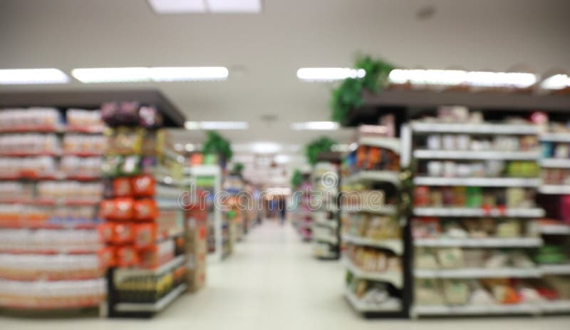

Collect transactional data
Take action
Preprocess the data
Interpret the results
HOW MARKET BASKET ANALYSIS WORK ?
Identify frequent item sets
Generate association rules
Calculate support and confidence

Slide 16
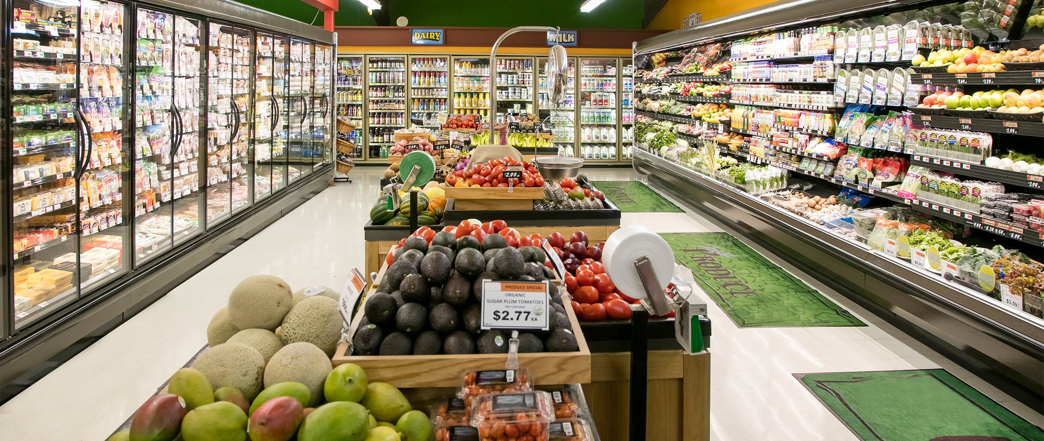
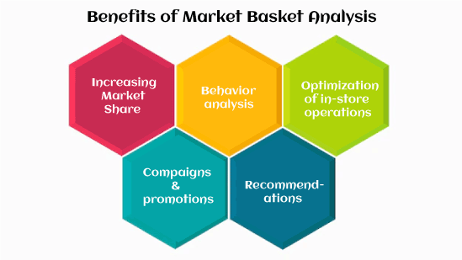
A
V
N
A
E
D
A
T
G
S

Slide 17
A
V
N
A
E
I
D
S
D
A
T
G
S
It cannot determine the causal relationship between them. It means that the businesses may not fully understand why certain products are frequently purchased together or how changes in one product may affect the sales of other products.
The accuracy and quality of the data used in market basket analysis can significantly impact the validity of the results.
Analyzing consumer transaction data can be a complex and time-consuming process that requires specialized skills and resources, such as data analysts and statistical software.
Analyzing consumer data can raise ethical concerns related to customer privacy and data security..
Market basket analysis is limited to the data available within a particular data set.

Slide 18


CONCLUSION
Cross-selling and upselling is the secret mantra of the retail industry that pushed the consumer to buy more. It has become a thriving factor for such industries that harness patterns with market basket analysis in data mining and derive customer insights to upscale their brand's performance.

Slide 19

REFERENCE
From the kaggle website we can use this real life data set:
https://www.kaggle.com/datasets/aslanahmedov/market-basket-analysis

Slide 20


